Slide 1
Linux Scheduling
Nirmala Shinde Baloorkar
Assistant Professor
Department of Computer Engineering

Slide 2
Outline
Fair Share Scheduling
Traditional UNIX Scheduling
Notes:
https://www.cl.cam.ac.uk/teaching/2324/OpSystems/materials/

Slide 3

Fair-Share Scheduling
Scheduling decisions based on the process sets
Each user is assigned a share of the processor
Objective is to monitor usage to give fewer resources to users who have had more than their fair share and more to those who have had less than their fair share
Notes:
All of the scheduling algorithms discussed so far treat the collection of ready
processes as a single pool of processes from which to select the next running process.
This pool may be broken down by priority but is otherwise homogeneous.
However, in a multiuser system, if individual user applications or jobs may be
organized as multiple processes (or threads), then there is a structure to the collection
of processes that is not recognized by a traditional scheduler. From the user’s
point of view, the concern is not how a particular process performs but rather how
his or her set of processes, which constitute a single application, performs. Thus, it
would be attractive to make scheduling decisions on the basis of these process sets.
This approach is generally known as fair-share scheduling. Further, the concept can
be extended to groups of users, even if each user is represented by a single process.
For example, in a time-sharing system, we might wish to consider all of the users
from a given department to be members of the same group. Scheduling decisions
could then be made that attempt to give each group similar service. Thus, if a large
number of people from one department log onto the system, we would like to see
response time degradation primarily affect members of that department rather than
users from other departments.
The term fair share indicates the philosophy behind such a scheduler. Each
user is assigned a weighting of some sort that defines that user’s share of system
resources as a fraction of the total usage of those resources. In particular, each
user is assigned a share of the processor. Such a scheme should operate in a more
or less linear fashion, so that if user A has twice the weighting of user B, then in
the long run, user A should be able to do twice as much work as user B. The objective
of a fair-share scheduler is to monitor usage to give fewer resources to users
who have had more than their fair share and more to those who have had less than
their fair share.

Slide 4
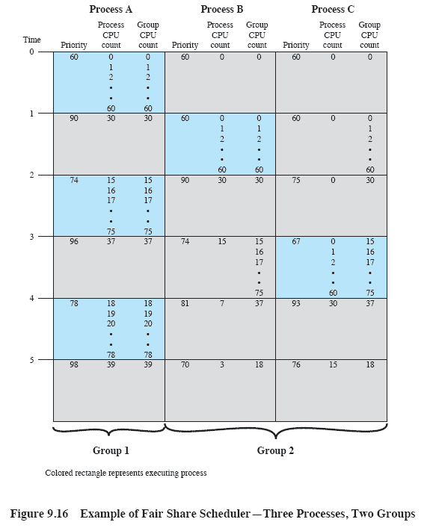
Fair-Share Scheduler
Notes:
Figure 9.16 is an example in which process A is in one group and processes B
and C are in a second group, with each group having a weighting of 0.5. Assume that
all processes are processor bound and are usually ready to run. All processes have
a base priority of 60. Processor utilization is measured as follows: The processor is
interrupted 60 times per second; during each interrupt, the processor usage field of
the currently running process is incremented, as is the corresponding group processor
field. Once per second, priorities are recalculated.
In the figure, process A is scheduled first. At the end of one second, it is
preempted. Processes B and C now have the higher priority, and process B is scheduled.
At the end of the second time unit, process A has the highest priority. Note
that the pattern repeats: the kernel schedules the processes in order: A, B, A, C, A,
B, and so on. Thus, 50% of the processor is allocated to process A, which constitutes
one group, and 50% to processes B and C, which constitute another group.

Slide 5
Traditional UNIX Scheduling
Used in both SVR3 and 4.3 BSD UNIX
these systems are primarily targeted at the time-sharing interactive environment
Designed to provide good response time for interactive users while ensuring that low-priority background jobs do not starve
Employs multilevel feedback using round robin within each of the priority queues
Makes use of one-second preemption
Priority is based on process type and execution history
Notes:
In this section we examine traditional UNIX scheduling, which is used in both
SVR3 and 4.3 BSD UNIX. These systems are primarily targeted at the time-sharing
interactive environment. The scheduling algorithm is designed to provide good
response time for interactive users while ensuring that low-priority background
jobs do not starve. Although this algorithm has been replaced in modern UNIX
systems, it is worthwhile to examine the approach because it is representative of
practical time-sharing scheduling algorithms. The scheduling scheme for SVR4
includes an accommodation for real-time requirements, and so its discussion is
deferred to Chapter 10 .
The traditional UNIX scheduler employs multilevel feedback using round
robin within each of the priority queues. The system makes use of one-second
preemption. That is, if a running process does not block or complete within one
second, it is preempted. Priority is based on process type and execution history.

Slide 6
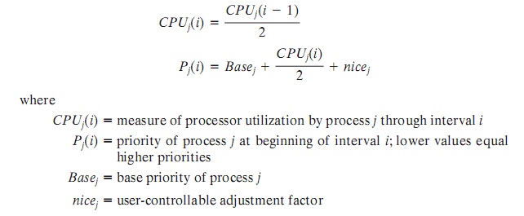
Scheduling Formula
Notes:
The priority of each process is recomputed once per second, at which time a
new scheduling decision is made. The purpose of the base priority is to divide all
processes into fixed bands of priority levels. The CPU and nice components are
restricted to prevent a process from migrating out of its assigned band (assigned by
the base priority level). These bands are used to optimize access to block devices
(e.g., disk) and to allow the operating system to respond quickly to system calls.

Slide 7
Bands
Used to optimize access to block devices and to allow the operating system to respond quickly to system calls
In decreasing order of priority, the bands are:
Swapper
Block I/O device control
File manipulation
Character I/O device control
User processes
Notes:
In decreasing order of priority, the bands are:
• Swapper
• Block I/O device control
• File manipulation
• Character I/O device control
• User processes
This hierarchy should provide the most efficient use of the I/O devices.
Within the user process band, the use of execution history tends to penalize processor-
bound processes at the expense of I/O-bound processes. Again, this should
improve efficiency. Coupled with the round-robin preemption scheme, the scheduling
strategy is well equipped to satisfy the requirements for general-purpose
time sharing.

Slide 8
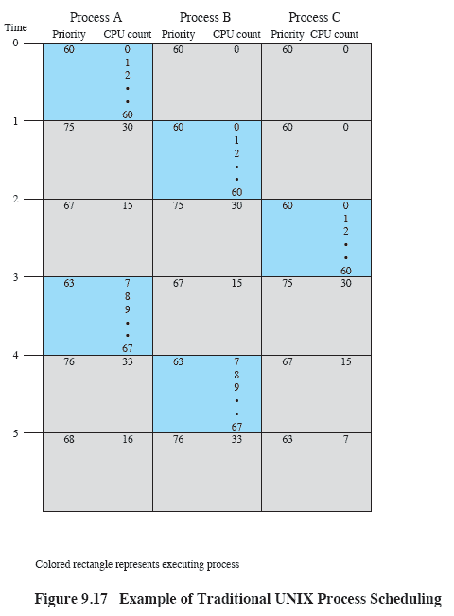
Example of Traditional UNIX Process Scheduling
Notes:
An example of process scheduling is shown in Figure 9.17 . Processes A, B,
and C are created at the same time with base priorities of 60 (we will ignore the
nice value). The clock interrupts the system 60 times per second and increments
a counter for the running process. The example assumes that none of the processes
block themselves and that no other processes are ready to run. Compare
this with Figure 9.16 .

Slide 9
Linux Scheduling Through Version 2.5
Prior to kernel version 2.5, ran variation of standard UNIX scheduling algorithm
Version 2.5 moved to constant order O(1) scheduling time
Preemptive, priority based
Two priority ranges: time-sharing and real-time
Real-time range from 0 to 99 and nice value from 100 to 140
Map into global priority with numerically lower values indicating higher priority
Higher priority gets larger q
Task run-able as long as time left in time slice (active)
If no time left (expired), not run-able until all other tasks use their slices
All run-able tasks tracked in per-CPU runqueue data structure
Two priority arrays (active, expired)
Tasks indexed by priority
When no more active, arrays are exchanged
Worked well, but poor response times for interactive processes

Slide 10
Linux Scheduling in Version 2.6.23 +
Completely Fair Scheduler (CFS)
Scheduling classes
Each has specific priority
Scheduler picks highest priority task in highest scheduling class
Rather than quantum based on fixed time allotments, based on proportion of CPU time
2 scheduling classes included, others can be added
default
real-time

Slide 11
Linux Scheduling in Version 2.6.23 + (cont…)
Quantum calculated based on nice value from -20 to +19
Lower value is higher priority
Calculates target latency – interval of time during which task should run at least once
Target latency can increase if say number of active tasks increases
CFS scheduler maintains per task virtual run time in variable vruntime
Associated with decay factor based on priority of task – lower priority is higher decay rate
Normal default priority yields virtual run time = actual run time
To decide next task to run, scheduler picks task with lowest virtual run time

Slide 12
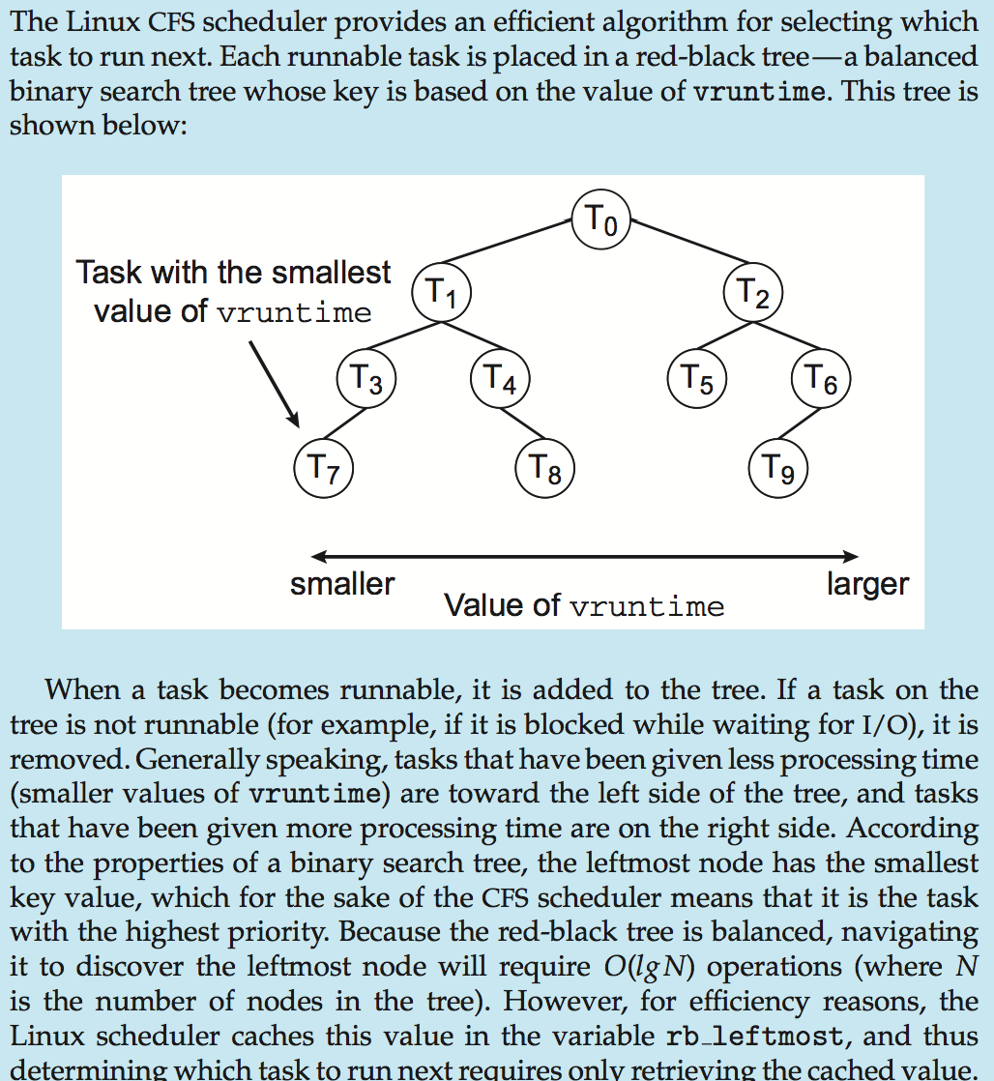
CFS Performance

Slide 13
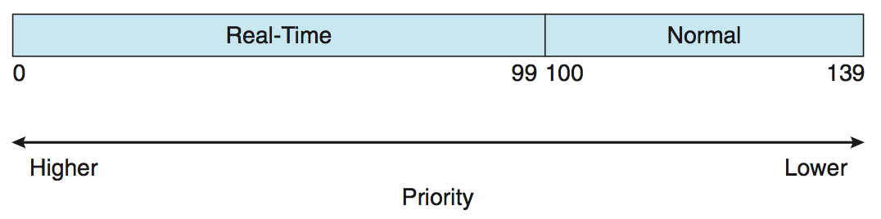
Linux Scheduling (Cont.)
Real-time scheduling according to POSIX.1b
Real-time tasks have static priorities
Real-time plus normal map into global priority scheme
Nice value of -20 maps to global priority 100
Nice value of +19 maps to priority 139

Slide 14
Question ?

